Slide 1
Lecture – 5 Introducing C’s program Control Statement

Slide 2
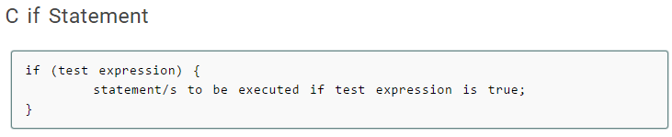
Become familiar with if
The if statement is one of the C’s selection statements (sometimes called conditional statements).
Selection Statements make decisions based upon the outcome of some condition.

Slide 3
The if statement checks whether the text expression inside parenthesis () is true or not.
If the test expression is true, statement/s inside the body of if statement is executed.
If test is false, statement/s inside body of if is ignored.
For example:
if( 10 > 9 )
{
printf(“this will be printed”);
}
This will print the message as the condition evaluates to be true.

Slide 4
Let us consider another example:
if( 5 > 9 )
{
printf(“this will not be printed”);
}
This will not print the message as the condition evaluates to be false.

Slide 5
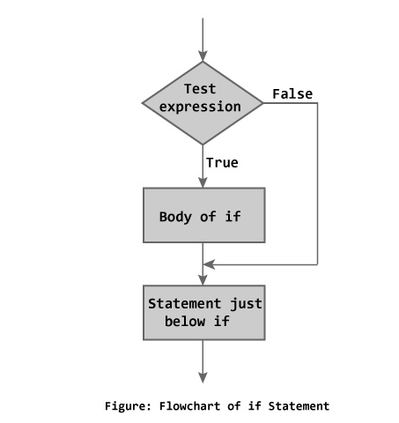
Flow Chart of if statement

Slide 6
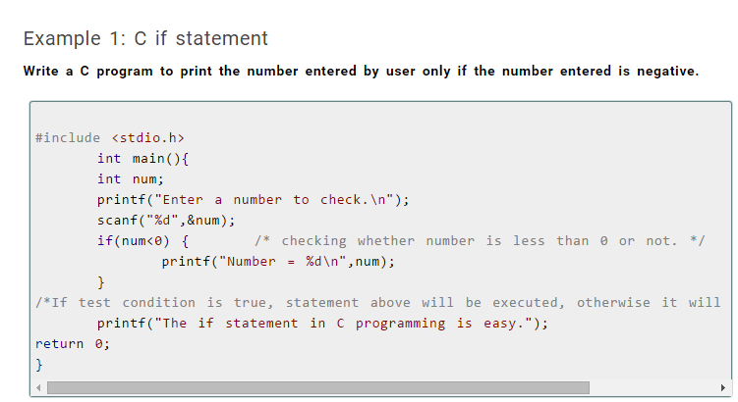

Slide 7
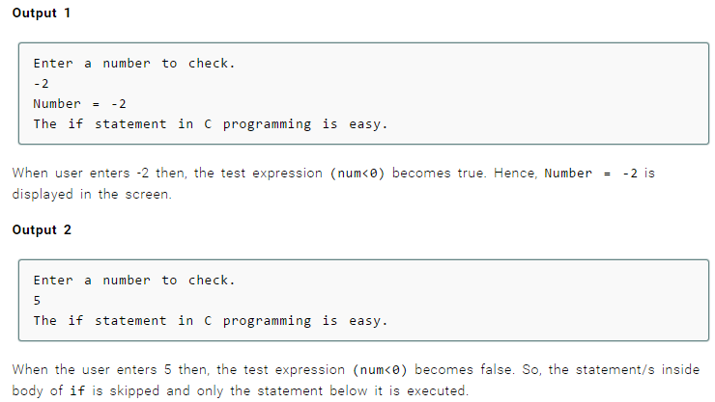

Slide 8
#include <stdio.h>
int main()
{
int num;
printf(“Enter an integer”);
scanf((“%d”,&num);
if(num < 0 ) printf(“Number is negative”);
if(num > -1) printf(“Number is non- negative”);
return 0;
}

Slide 9
This program displays two numbers and asks user what the answer is.
The program then tells the user if the answer is right or wrong.
#include<stdio.h>
int main()
{
int answer;
printf(“What is 10 + 14”);
scanf(“%d”,&answer);
if(answer== 10+14) {
printf(“Right”);
}
return 0;
}

